Slide 1
‘Smokefree Squad’ - Using professional sports settings to refer fans to stop smoking services
Dr Matthew Philpott, PhD
Director, European Healthy Stadia Network
UK NSCC, London – 28/6/2013

Slide 2
Overview of Presentation
Healthy Stadia Network – Who are we & what do we do?
Rationale and objectives of Smokefree Squad campaign
Social marketing materials & communications
Training programme & efficacy
Roll out and key outputs
Conclusions, learning and latest developments

Slide 3
Healthy Stadia Network
Network formed in 2009 – founded upon learning and partnerships developed through 30 month EU pilot project and work with Merseyside stadia since 2005; Network a CIC based within UK Health Equalities Group
Aims to support sports clubs and their stadia become health promoting settings i.e. developing health policies and practices at stadia and within local communities
Network has membership of over 200 stadia - shares examples of good practice, acts as advocacy and lobbying voice for health and sports stadia, and provides bespoke health consultancy and project support for clubs
Part funded by World Heart Federation through health partnership with UEFA’s Football and Social Responsibility Programme.

Slide 4
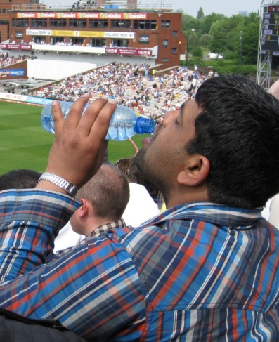
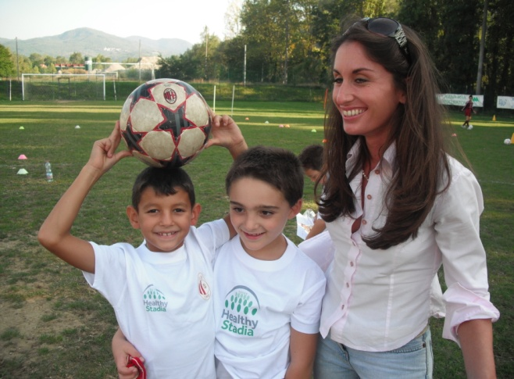
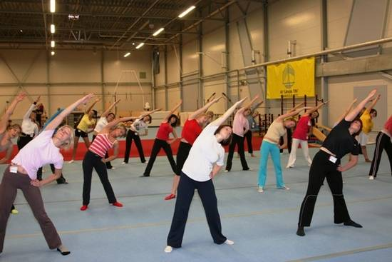
Healthy Stadia Concept
A holistic approach to developing stadia as ‘health promoting settings’:
“Healthy Stadia are those which promote the health of visitors, fans, players, employees and the surrounding community... Places where people can go to have a positive, healthy experience playing or watching sport”

Slide 5
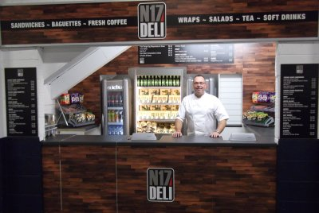
Stadia Health Policies Supporting Community Actions
Active travel plans to stadia for fans and staff
Healthier and sustainable food and drink options
Community & staff use of fitness facilities
Workplace wellness policies to improve staff health
Sustainability practices benefitting public health
Tobacco free stadia policies & smoking cessation

Slide 6
Smokefree Squad: Campaign Rationale
Nationally 21% of adults smoke - in the North West smoking prevalence is higher at 23%, with men smoking more (22%) than women (21%)
30% of men and 27% of women in routine and manual occupations smoked compared to 15% of men and 14% of women in managerial and professional occupations (2009)
Owing to the prevalence of male fans in routine and manual occupations attending sports stadia, there are real possibilities of using sports stadia and their clubs to refer fans and those in local communities to LSSS
Smokefree legislation only covers enclosed stadia - good opportunity for brief interventions outside enclosed stadia and inside open stand stadia
Notes:
6

Slide 7
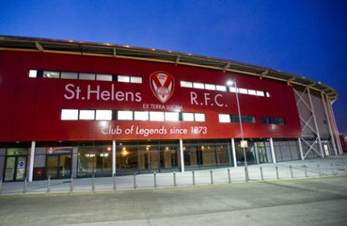
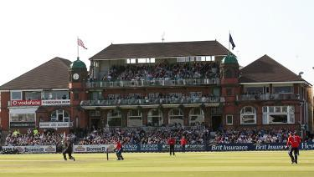
Building the Squad
Origins of the project:
Originally approached Pfizer about project on health checks run at stadia (Aug 2011)
Pfizer interested in running smoking cessation brief interventions in new settings
Partnered with Tobacco Control lead from Heart of Mersey to scope pilot project
Partnered two sports stadia in North West:
Langtree Park - St Helens Rugby League Club (enclosed stadium - smokefree)
Old Trafford – Lancashire County Cricket Club (open stands - smoking allowed out of sight of playing area)
Notes:
Through smokefree legislation introduced in 2007, covered stands at sports stadia in the UK are now smokefree areas. This has benefitted both fans and staff through the elimination of secondhand smoke within stands, whilst creating an environment conducive to giving up smoking and remaining quit. It has also denormalised smoking to protect children and young people from initiating the habit. There are also opportunities outside of sports stadia and in community settings near to stadia to encourage male fans in routine and manual occupations to quit.
In response, funding was obtained from Pfizer to pilot a smoking cessation brief intervention training programme and an overarching public facing social marketing campaign in two iconic sports stadia in the North West of England - Langtree Park Stadium (St Helens Rugby League Club) and Old Trafford (Lancashire County Cricket Club):
Langtree Park: As Langtree Park is composed of ‘closed’ stands, smoking is entirely prohibited within the stadium and at entrances. However, fans smoking outside the stadium on match-days can still be engaged by stewards and key staff in smoking cessation brief interventions. In addition, the strong community links of the Saints Foundation, presented an opportunity for community coaches to deliver brief interventions and circulate the social marketing materials to local families.
Old Trafford: As Old Trafford has ‘open’ stands, smoking is still allowed inside the stadium out of sight of the playing areas. This offered a strong setting for stewards to offer smoking cessation brief interventions to fans on match-days and to signpost them to relevant NHS Local Stop Smoking Services (LSSS). Again we also worked with the newly formed LCCC Foundation to communicate stop smoking messages at junior coaching sessions.

Slide 8
2012 Smokefree Squad Pilot
Pilot project scheduled to run at both clubs June-September 2012
Idea to use stewards, coaches and communications channels at club to help fans give up smoking through referral to quit services
Two main components to campaign:
Brief interventions delivered by stewards and coaches using brief intervention / advice techniques
Social marketing materials given out on match day and in community settings
Notes:
8

Slide 9
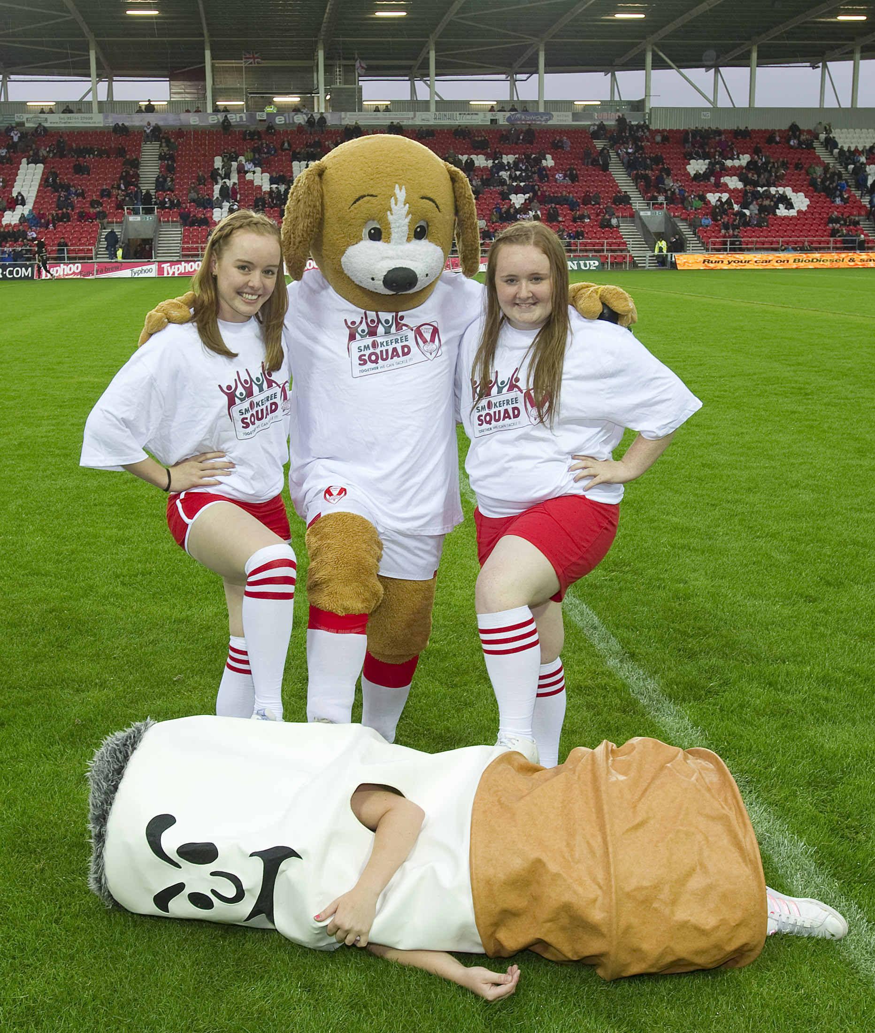
Campaign Key Aims
Increase awareness of the benefits of being smokefree & the availability of stop smoking services among stadia staff, fans and the local community
Signpost smokers who want to quit to Local Stop Smoking Services
De-normalise smoking among children & young people & empower them to stay smokefree
Trial smoking cessation brief interventions in sports stadia settings
Notes:
9

Slide 10
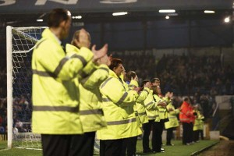
Role of Stewards and Community Coaches
Give verbal information on dangers of
smoking and distribute social marketing
resources to fans, local communities
& club colleagues
Signpost smokers who want to quit to
Local Stop Smoking Services
Talk about their own experience - if they
were an ex-smoker, speak to fans about
how they quit and how many times it took
Record the number of people they gave
information and advice to in a bespoke diary produced for the campaign
Notes:
We would like you to give out information about the positive benefits of being smokefree to colleagues, fans and young people within your community programmes. As a steward or coach people respect you and look to you for honest advice – therefore you are well placed to guide people in choosing a healthier lifestyle. This could include better health, increased stamina to play sport, nicer smelling breath and clothes and more money to buy essentials such as food or treats such as a meal out, trip to the cinema, downloads, CDs and games. It’s important to focus on the positive aspects rather than labelling people as ‘bad’ if they smoke. By spending just a couple of minutes talking to fans and the local community you can help them be smokefree.
It’s important not to give mixed messages. If you do smoke, or have smoked in the past, try not to hide this fact from fans. Use your experience as an advantage by letting them know you want to help them to avoid some of the unhealthy decisions you’ve made. Emphasise how hard is to quit but if you’ve done it they can do it too! As a role model it’s important to set a good example and not to smoke in front of fans or the local community particularly children and young people – model the behaviour you would like them to assume.

Slide 11
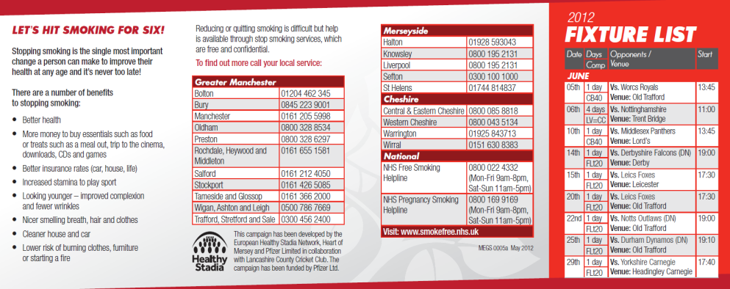
Materials and Messaging
Used focus groups of club staff, stewards and fans to devise campaign brand, training & marketing materials
Club related educational materials contained LSSS contact numbers, text referral number, QR code, and unique reference to track referrals into LSSS
Materials and communications used player endorsements & targeted messaging e.g. consequences of smoking on sports performance, cost of smoking, smell of smoke etc

Slide 12
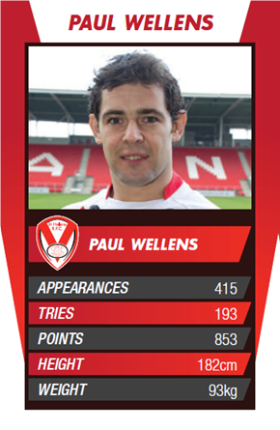
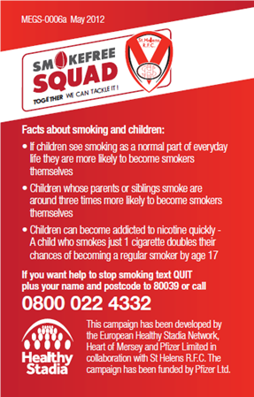
Marketing Materials & Communications
Key materials and communications channels:
8,000 Z-cards with match fixtures
8,000 ‘Top Trumps’ player cards
A3 Posters with QR code
Portable kiosks & feather banners
T-shirts & caps for stewards
Campaign web pages and web banner
‘Match day programme’ articles
Twitter Feed & Facebook (inc Mascots)
Launch match press calls
Key article in press & ‘Advisor’ magazine
Notes:
At the start of the initiative we undertook focus groups with 18 staff from Saints Lancashire County Cricket Club to develop both the training programme and public facing resources to ensure they were appropriate and met community needs. A selection of resources were developed.
12

Slide 13
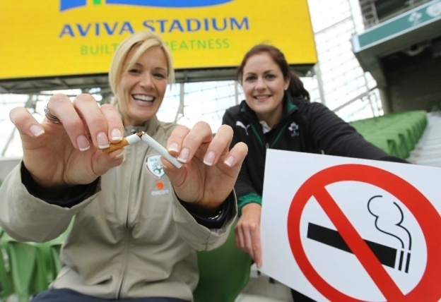
Brief Intervention Training
Training course devised & delivered by Tobacco Control Lead for Heart of Mersey (Jo McCullagh)
90 minute interactive session:
Icebreaker - Smokefree quiz
Quit smoking support – LSSS
Delivering a brief intervention -
based on ‘Ask, Advise, Assist’ model
Practice through 1-2-1 role-play
Defining the stewards/coaches role
Dealing with potential conflict
Training resource pack:
Tobacco free toolkit – training booklet, quiz, smokefree wheel
A6 diary to record number of people given advice & support over three-month period
Notes:
The bespoke brief intervention training programme focuses primarily on the delivery role of stewards, community foundation staff and coaches, and aims to increase stadia staff’s knowledge and skills of how to support fans, other members of staff and the community to quit smoking. In turn, this will assist service referral and access rate. The training comprised a 90 minute interactive session, which addressed the following areas:
The impact of smoking and benefits of quitting quiz
Quit smoking support
Quitters experience: Today I Can film
Raising the issue: A brief intervention, including role-play
Trainees role
Dealing with potential conflict
All participants were also allocated a toolkit to facilitate smoking cessation activity with fans, colleagues and community contacts and an A6 diary to record the number of people given advice and support on a weekly basis over a three-month period.

Slide 14
Efficacy of Training
Saints RFC: 20 staff trained (14 stewards & 6 Community Foundation staff)
LCCC: 27 staff trained (8 stewards & 19 community coaches)
Staff trained month before launch - participants completed 17 question training evaluation. All participants intended to incorporate stop smoking advice into their working practice: habitually (72.1%), or sometimes (27.9%)
Learning Outcome | Median Score/5* | (25,75 percentiles)
 | Saints | LCCC
Was your objective for the training achieved? | 5 (4,5) | 4 (4,5)
I have a greater understanding of smokefree and stop smoking issues | 5 (4,5) | 4 (4,5)
My knowledge of smokefree issues and stop smoking advice has increased | 5 (4,5) | 4 (4,5)
My ability to disseminate information regarding smokefree issues and stop smoking to the public has increased | 5 (4,5) | 4 (4,5)
Notes:
The efficacy of the training was assessed using a short questionnaire, which was distributed on completion of the sessions. Overall, the course was well received and achieved all of the trainees learning outcomes and requirements. Following the session participants had a greater understanding and felt more knowledgeable about smoking cessation and felt their ability to disseminate stop smoking advice to the public had increased.
All of the participants also intended to incorporate stop smoking advice into their working practice some or all of the time. This high level of satisfaction was also born out in open-ended commentary.

Slide 15
Efficacy of Training
“I thought the training session was very good and I learned more than I thought we would. I can pass on to others all the information I have learned.”
“Useful session and going to use it with family, friends and spectators at the ground.”
“Some pieces of information on the dangers of tobacco use I had no idea about. Interested to hear about local services available”
“90 minutes was about right, nothing too hard.”

Slide 16
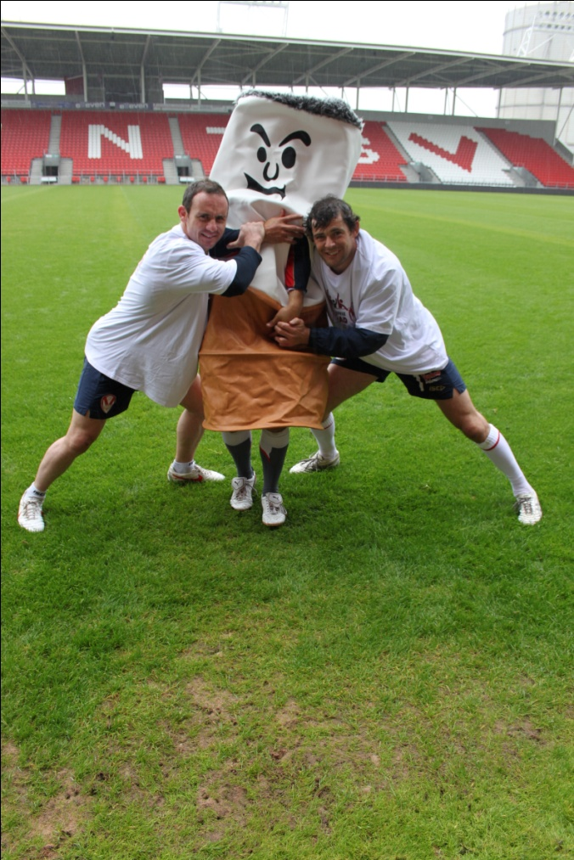
Programme Outputs: Saints
Over a 3 and half month period:
2,058 people given Stop Smoking advice:
Stewards – 821
Community Coaches – 1,237
77 referrals to Stop Smoking Services (3.75%):
Cheshire & Merseyside – 47
Out of area- 30
47 C&M referrals:
Didn’t set a quit date – 23
Lost to follow up – 2
Relapsed – 15
Quit – 7
Notes:
The lifetime benefit of every adult smoker who quits is 1.24 years valued at £74,400 (Department of Health (2012). Impact Assessment of standardised packaging for tobacco products. DH, April 2012).
Therefore whilst the number of quits from this activity is small, the combined lifetime benefit would be £520,800 which is a high return for a campaign which cost £30,000 (£342,000 profit)

Slide 17
Learning & Feedback
Both clubs were very happy with pilot, publicity gained and the way it used their staff for social good without impacting on their core role; win-win
Stewards participating in the campaign commented that interventions raised their self esteem and brought them closer to fans – willingness to repeat
Saints stewards and community staff have incorporated brief intervention techniques into mandatory training at start of 2013 season
Stewards from LCCC worked on ad hoc basis – not enough continuity over season to get used to delivering interventions, and tracking in diaries; major problem gaining set of results from LCCC pilot, both from stewards & LSSS
Need to make tracking codes more prominent on materials and work more closely with LSSS to capture referrals from campaign

Slide 18
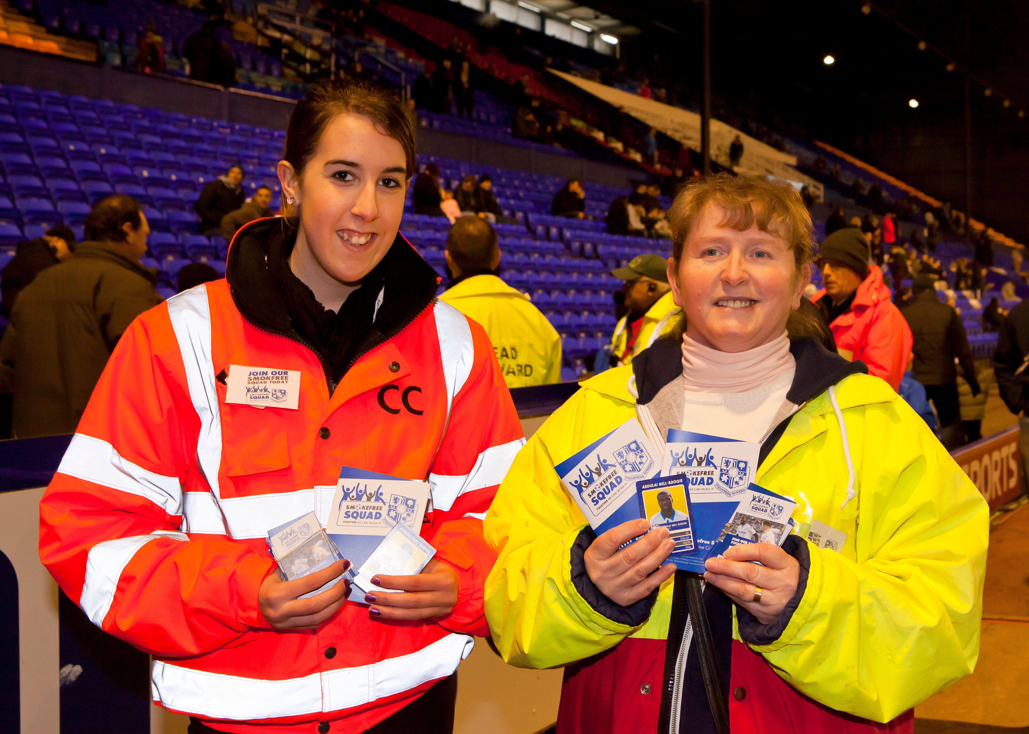
Kicking It at Tranmere Rovers FC
Tranmere Rovers Football Club, Merseyside
Seven week programme, mid-February to March 2013; 6 home games in all
16 Stewards & community coaches trained
LSSS assisted with match day support
Offer of stop smoking drop in clinic at Prenton Park stadium every Thursday
853 recorded interventions from clubs stewards and community staff
New commission from Knowsley MBC – focus on amateur club settings, Jan 2014

Slide 19
Many thanks to Pfizer for funding the pilot campaign
Any questions?
Matthew Philpott: matthew.philpott@healthystadia.eu
Twitter - @healthystadia
Join the Healthy Stadia Network free of charge at:
www.healthystadia.eu

